Slide 1
CX Quality Assessment
DiDi Global — CX Service Operations | Delivery / Food LOB
Week W22 | Weekly Performance Report (Entregable 2)
August 2026

Slide 2
Methodology — DMAIC Framework
Phase | Purpose | This assessment
Define | Scope, KPI contract, problem statement | 3 KPIs: QA 85 · CSAT 85% · Recontact ≤5.44%
Measure | Baseline performance & data integrity | 2,460 audits · 77,266 surveys
Analyze | Why KPIs behave as they do | Correlations, Pareto, RCA, CR Lv4 deep dive
Improve | Structured action plan | 8-week phased plan · LOB owners
Control | Sustain gains & monitor drift | Weekly glide path · control charts · QA calibration

Slide 3
DEFINE
Project charter & KPI contract

Slide 4
Define — Problem Statement & Scope
Problem: CX quality metrics diverge — QA meets target while CSAT and recontact do not.
Scope: Phone + Live Chat · CR Lv4 granularity · Week W22 · Countries CO, MX, PE, CR.
Voice of leadership: identify where customers recontact, where satisfaction drops, and which
contact reasons require systemic FCR intervention — not only script compliance.
Data source: Business Case workbook · same logic as production dashboard (994,591 contacts).

Slide 5
MEASURE
On target

Slide 6
How the KPIs are behaving and why?
For Week W22, the current metrics are:
QA Score Current Score: 94.1% Target: 85
On target
CSAT Current Score: 80.0% Target: 85%
Not on target
Recontact Rate Current Score: 5.83% Target: 5.44%
Not on target
CSAT is systematically below target (80.0% vs 85%). This is the root problem we address in the Improve phase.
Global QA Score meets the goal at 94.1%, but Phone is at 83.0% on 355 audits (-2.0 points vs the 85% goal). The overall average hides it because the highest-volume channel accounts for 86% of the sample. Top failing attribute on that channel: Time management.

Slide 7
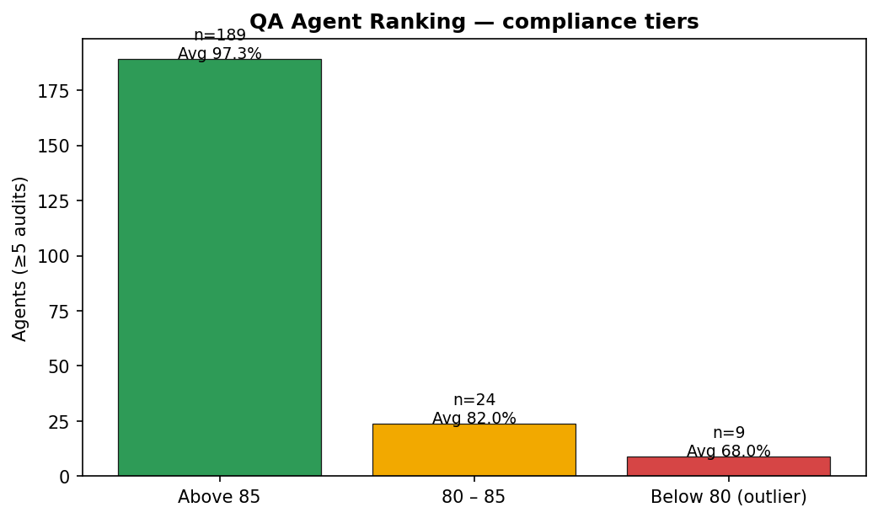
How the KPIs are behaving and why?
Ranking — QA agent compliance (≥5 audits)
Agents above 85%: 189 | Between 80–85%: 24 | Below 80% (outlier): 9
Average compliance: 94.5%
Any agent below 80% is considered an outlier and should enter an improvement plan.
Targeting the below-80 group addresses the majority of QA coaching deficit.

Slide 8
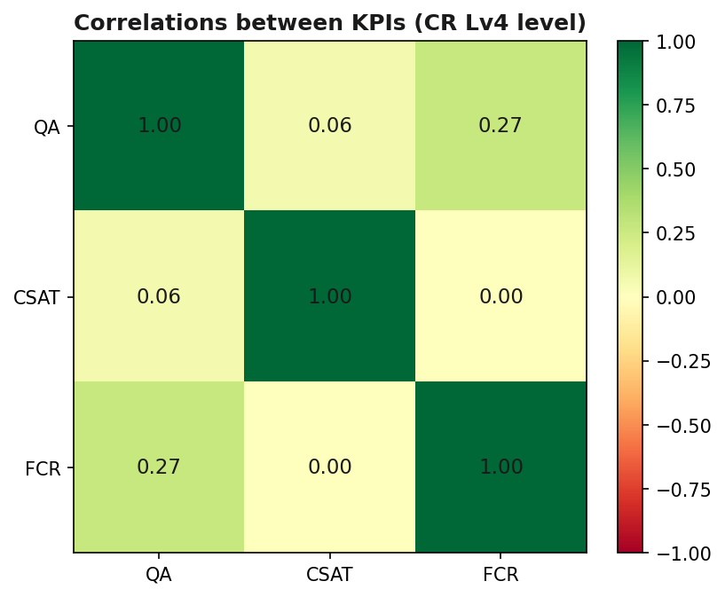
How the KPIs are behaving and why?
Correlations between the 3 KPIs (CR Lv4 level)
QA ↔ CSAT shows weak correlation (r=0.06) — perception gap vs audit score.
CSAT ↔ FCR (inverse recontact) r=0.00: low satisfaction aligns with repeat contacts.
QA ↔ FCR r=0.27: improving script compliance without FCR tools won't fix recontact.

Slide 9
How the KPIs are behaving and why?
QA — channel dispersion hides Phone gap
Phone QA: 83.0% (-2.0 pp vs goal) — Not on target
Live Chat QA: 96.0% (+11.0 pp) — On target
Global QA 94.1% meets target, but Phone is the weakest channel.
Top Phone defect: Time management.
Focus: agents between 70–85 on Phone CRs tied to delivery / refund.

Slide 10
How the KPIs are behaving and why?
CSAT KPI — population-level gap
Global CSAT 80.0% — Not on target (target 85.0%).
Live Chat CSAT: 77.6% drives the gap (72% of feedback).
Phone CSAT: 86.3% — on target.
CSAT is uncorrelated with QA on several high-volume CRs — improving QA alone won't fix CSAT.
We need targeted FCR + VOC interventions on order status / delay CRs.
Top VOC theme: Refund / compensation not received.

Slide 11
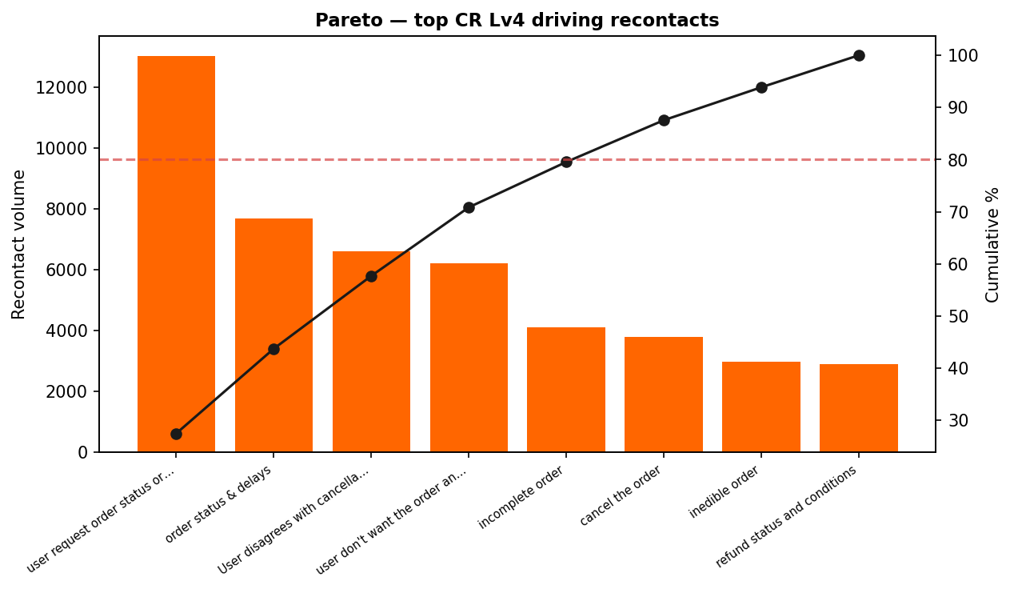
How the KPIs are behaving and why?
Prioritization — CR Lv4 cluster
Recontact rate 5.83% — Not on target (target ≤5.44%).
• user request order status or delay information: 13,014 recontacts (16.9% rate)
• order status & delays: 7,680 recontacts (19.3% rate)
• User disagrees with cancellation charge/debt: 6,599 recontacts (13.0% rate)
Priority #1 combined risk: order status & delays — Low CSAT + High Recontact
Targeting this cluster addresses the majority of the CSAT + recontact deficit.

Slide 12
ANALYZE
Root Cause Analysis

Slide 13
RCA — Validated root causes (data review)
Category | Root cause | Evidence
People | Phone agents under time pressure | Time management 37% fail rate Phone
Process | No FCR script for order status CRs | QA green + CSAT red on same CRs
Technology | Limited live tracking in chat | VOC: 'wait' / 'no information'
Policy | Refund/compensation rules unclear | Critical fails: info + compensation
Measurement | QA measures script not resolution | QA–CSAT weak correlation
Culture | Generic responses accepted | VOC themes: no solution
Most pressing: Process, People, Measurement, Training.

Slide 14
Combined Analysis — operational story
Global QA Score meets the goal at 94.1%, but Phone is at 83.0% on 355 audits (-2.0 points vs the 85% goal). The overall average hides it because the highest-volume channel accounts for 86% of the sample. Top failing attribute on that channel: Time management.
Hypothesis: For 'order status & delays', high recontact suggests potential resolution or escalation gaps; low CSAT correlates with VOC theme 'Refund / compensation not received'. This is an observable pattern only, not confirmed causality.
Quantified: top recontact CR = user request order status or delay information · worst combined CR = order status & delays.

Slide 15
IMPROVE
Action Plan to improve CSAT & Recontact

Slide 16
Action plan — Current Situation & Objective
Current CSAT score: 80.0% (Target: 85%)
Recontact rate: 5.83% (Target: ≤5.44%) | QA: 94.1% (maintain ≥85.0)
Observed issues:
• Live Chat CSAT drag despite high QA scores
• Order status / delay CRs drive 40%+ recontacts
• Phone QA gap on time management & critical information
Objective: Increase CSAT to ≥85% within 8 weeks while holding QA ≥85.0 and Recontact ≤5.44%.
Involved teams: Training · QA · Operations (Supervisors) · Product

Slide 17
Action plan
Phase 1: Foundation (Weeks 1–2)
Establish baseline coaching on Phone time management + order-status FCR scripts.
• Focused uptraining on Time management & Complete information (Training, 45–60 min)
• FCR job aid for order status / delay CRs (Training + QA)
• 1:1 coaching for Phone outlier agents <80% QA (Ops)
• QA alerts on Critical fails — 13 daily interactions reviewed (QA)

Slide 18
Action plan
Phase 2: Process & QA Alignment (Weeks 3–4)
Align QA, Training, and Ops on resolution — not only script compliance.
• QA calibration sessions 2×/week (QA + Ops + Training)
• Live tracking widget pilot in Live Chat for status CRs (Product + Ops)
• Daily tips on FCR behaviors via comms channels (Training + QA)
• Weekly performance report highlighting CR outliers (QA → Supervisors)

Slide 19
Action plan
Phase 3: Reinforcement (Weeks 5–6)
Sustain progress and reduce repeated QA errors.
• Weekly outlier tracking + follow-up coaching (QA + Ops)
• Recognition for agents maintaining ≥85% CSAT on audited CRs (Ops)
• Refresher on top VOC themes (QA + Training)
• Coaching compliance within 24h report (Ops → QA)

Slide 20
Action plan
Phase 4: Consolidation (Weeks 7–8)
Lock in gains and start next outlier cohort.
• Targeted coaching for CRs still below 75% CSAT (Ops)
• Continuous monitoring + findings to supervisors (QA)
• Final review — assess outcomes & next DMAIC loop
• Restart plan on next outlier agent group

Slide 21
Action plan — Activities matrix & LOB ownership
LOB / Type | Owner | Timeline | Action | KPI
Food | QA + Training | Wk 1–2 | Phone coaching: time mgmt + info | Phone QA → 85
Full Service | Ops + WFM | Wk 1 | Peak staffing · reduce chat wait | CSAT FS → 85%
Full Service | Product | Wk 2–4 | Tracking widget in chat | −3pp recontact status CRs
Market Place | LOB Lead | Wk 2–3 | Separate marketplace scripts | CSAT MP → 85%
All LOBs | CX Leadership | Wk 1 | War room top 3 recontact CRs | RC ≤ 5.44%
Strategic framework: clear accountability · who does what · by when.

Slide 22
CONTROL
How do we ensure effectiveness?

Slide 23
Control — Metrics & monitoring
Type | Metric | Target | Frequency
Primary KPI | CSAT % | ≥ 85.0% | Weekly
Primary KPI | Recontact rate | ≤ 5.44% | Weekly
Control | QA Score | ≥ 85.0 (±3pp max drift) | Weekly
Secondary | FCR on status CR cluster | ↑ 5pp vs baseline | Weekly
Secondary | QA alerts closed <24h | 100% | Daily
Secondary | QA calibration score | ≥ 95% | Per session
Secondary | Phone outlier agents <80% | ↓ 50% by week 6 | Bi-weekly

Slide 24
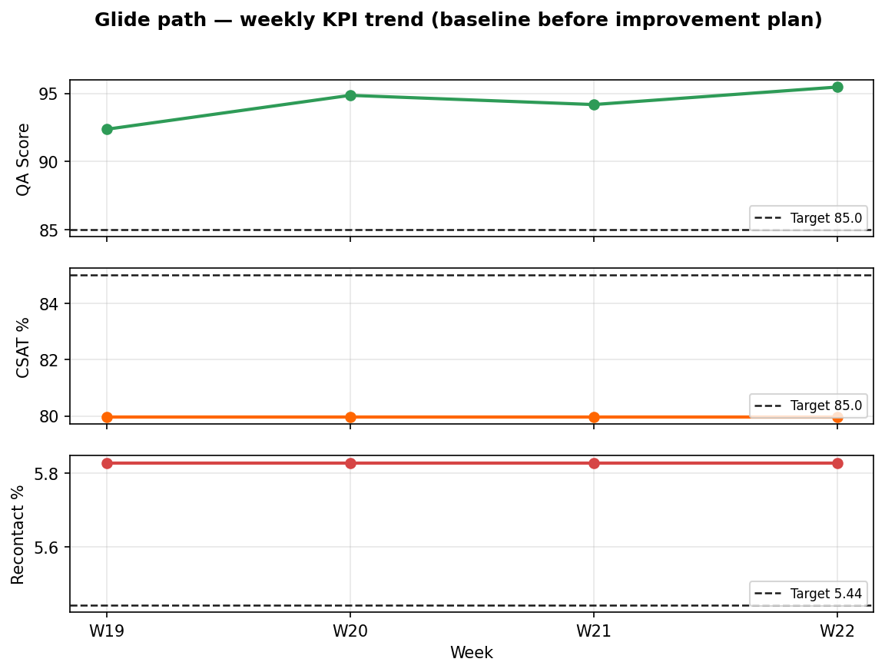
Glide path — weekly KPI trend
Baseline shows stable CSAT/recontact — improvement requires the action plan above.

Slide 25
Annex — 7 Quality Tools applied
Tool | DMAIC phase | Application
Check Sheet | Measure | Data validation & audit rules
Pareto | Analyze | Top defects & recontact CRs
Histogram | Measure | QA score distribution by channel
Control Chart | Control | QA by country / daily SPC
Scatter | Analyze | QA vs CSAT correlation
Ishikawa | Analyze | Root cause — order status cluster
Flowchart | Analyze | FCR failure path

Slide 26
Thank You

